Slide 1
12/9/22
Tested the algorithm to distinguish materials with a different material thickness.
Tested the algorithm to distinguish materials with added noise.
Trained an algorithm to remove backscattering (exactly 1 collision)!!!
Haven’t tested on stoichiometry yet.

Slide 2
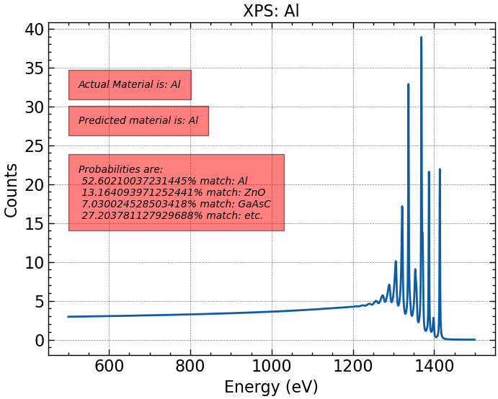
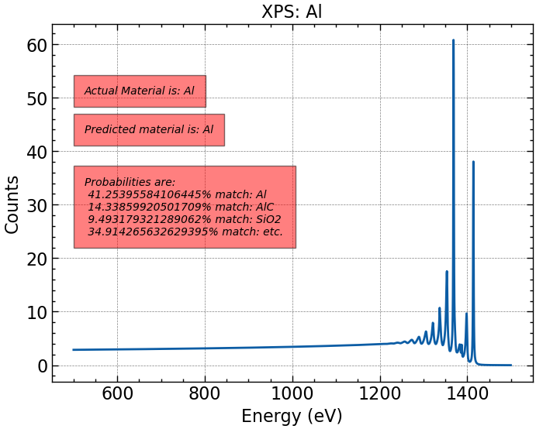
Algorithm trained on 10 Angstrom thickness (no training data with noise):
Algorithm on training data (left) vs. 40 Angstrom test data.

Slide 3
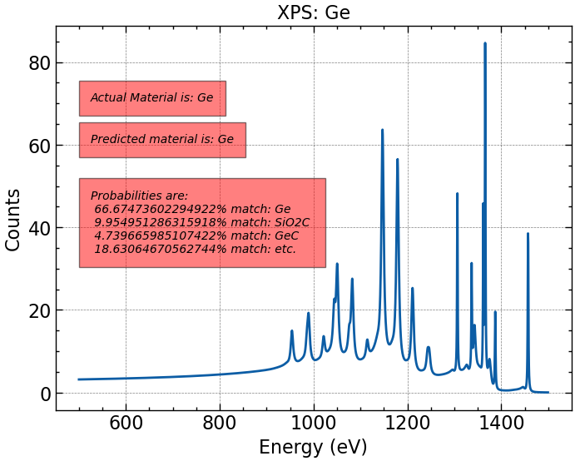
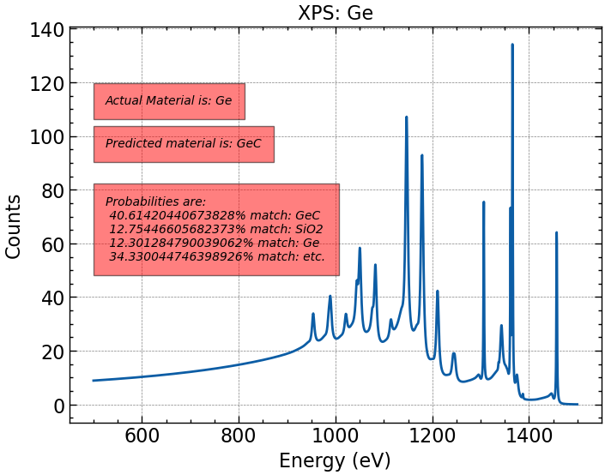
Same parameters. About 70% of predictions were right. When they were wrong, the predicted material was the same material with a light carbon layer. This likely means that if we train on a broad spectrum of thicknesses, the prediction algorithm should also perform well. How this would do on a thickness closer to 10 Angstroms has yet to be seen.

Slide 4
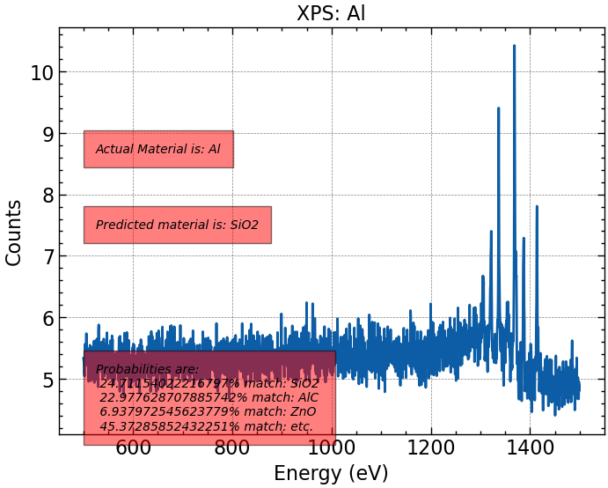
Same algorithm, tested with noise.
Tons of poisson noise (and normalization) added. BAD BAD BAD. To be expected when algorithm is trained on very “clean” data.

Slide 5
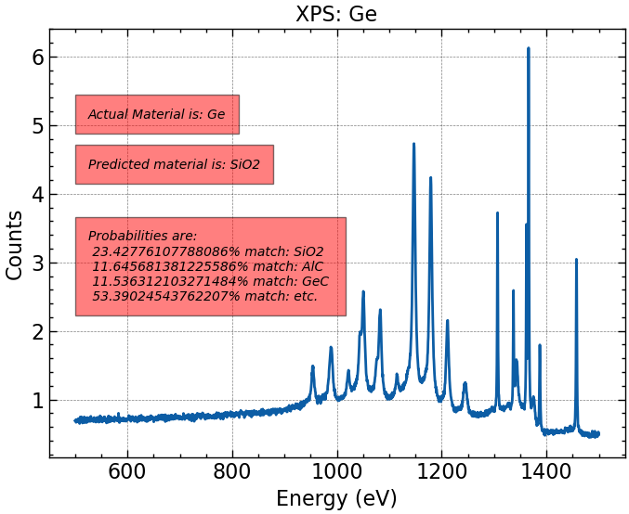
Way less poisson noise (and normalization) added. Still horrendous. Next to try is training the algorithm with poisson data.
It might be interesting to note that almost everything was predicted to be SiO₂ and that the only correct match was Al.

Slide 6
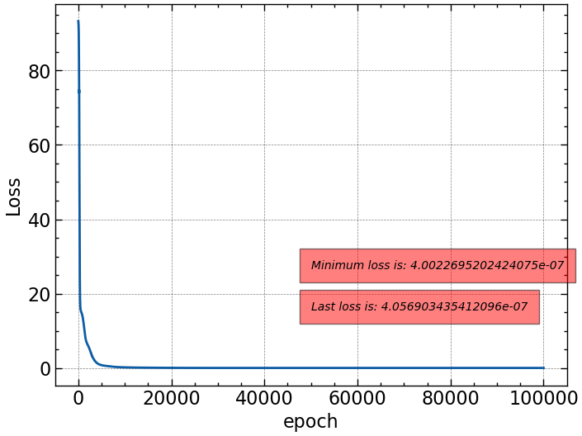
Eliminating back-scattering.
Negligible loss was achieved very quickly. Spectra are normalized, and algorithm is trained on 20 materials at a 10 Angstrom thickness.

Slide 7
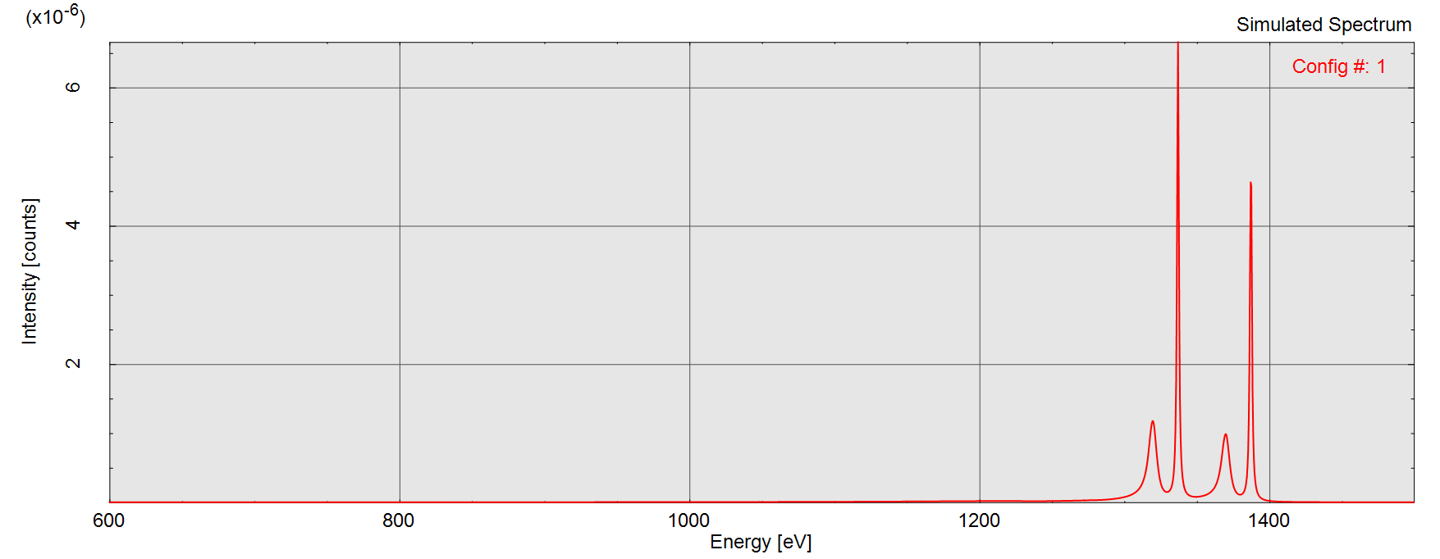
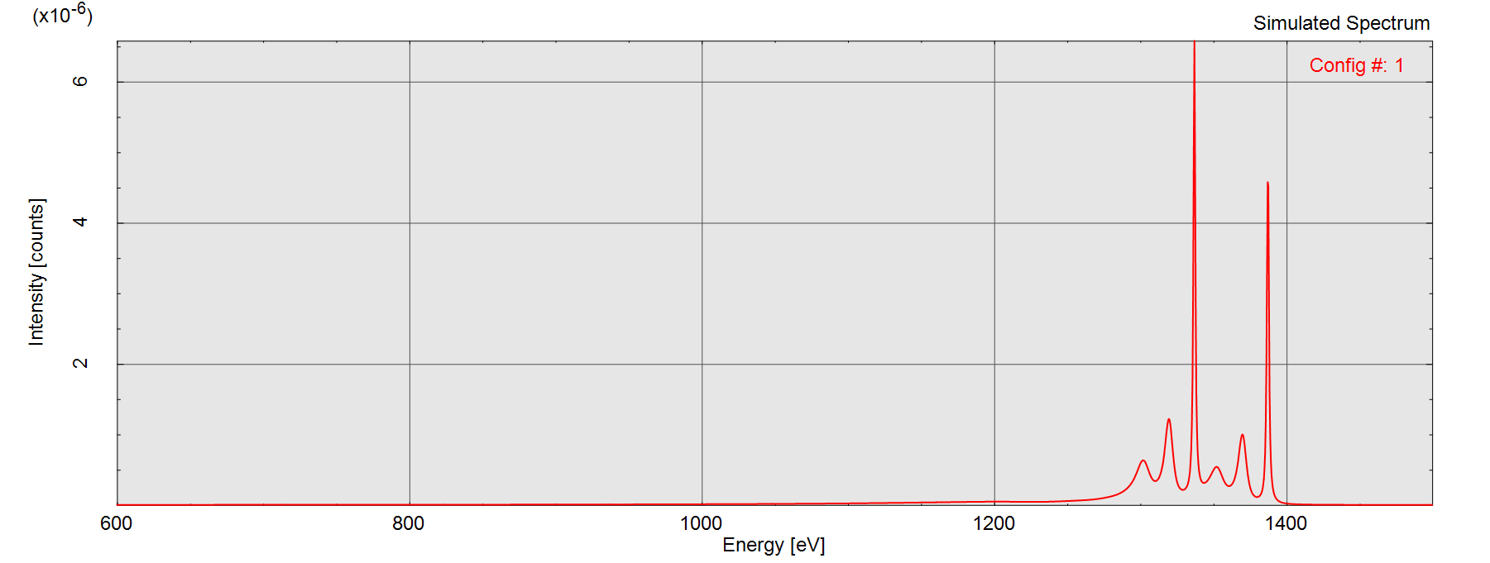
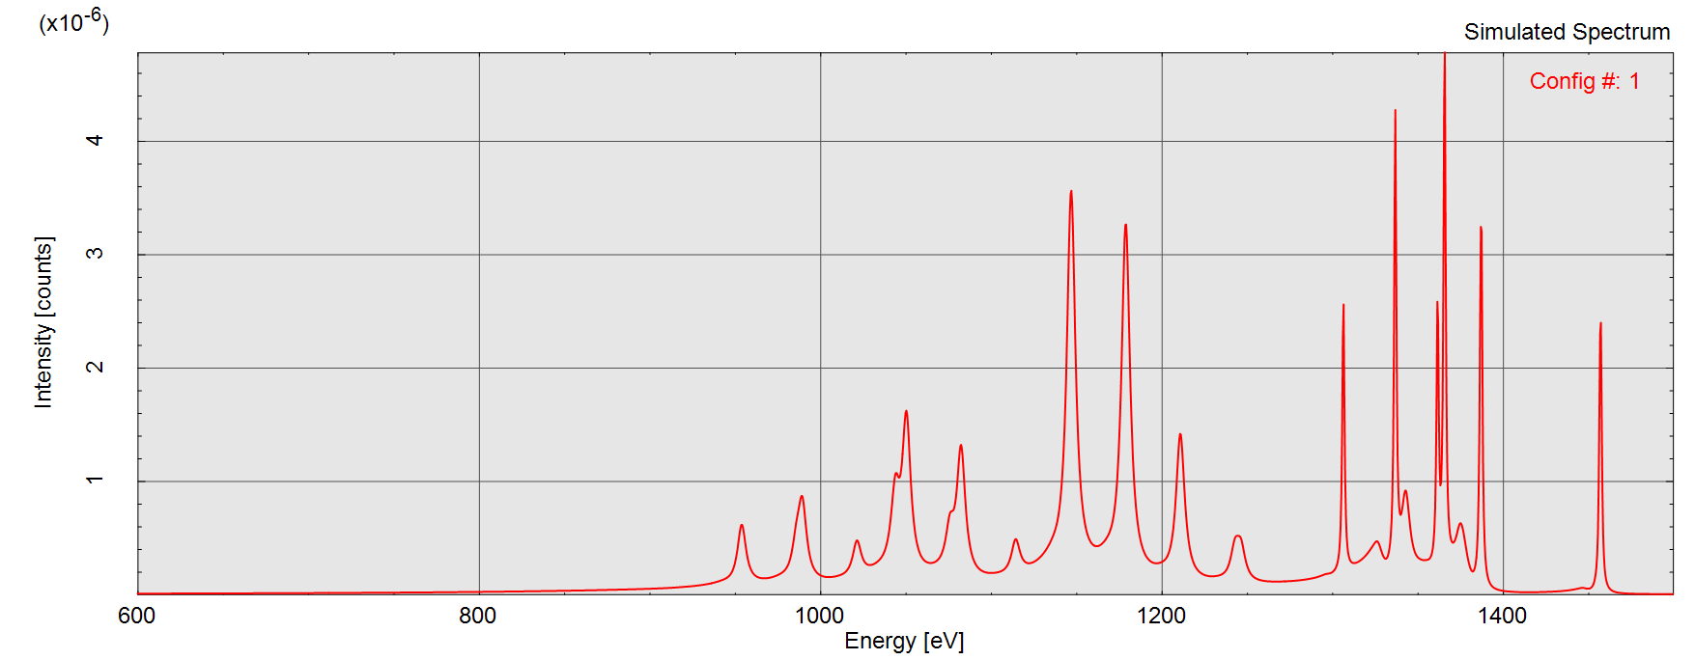
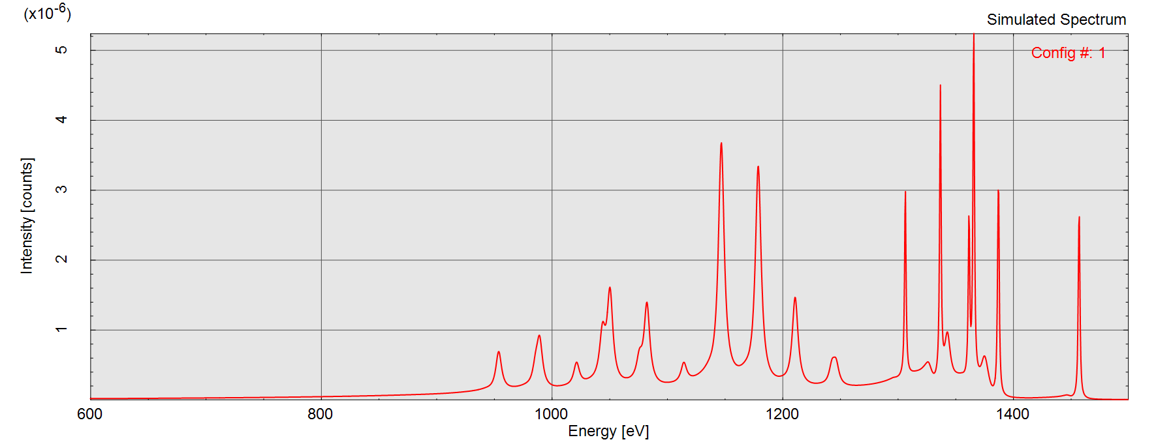
1 Collision. Si (top), Ge (bottom).
2 Collisions.

Slide 8
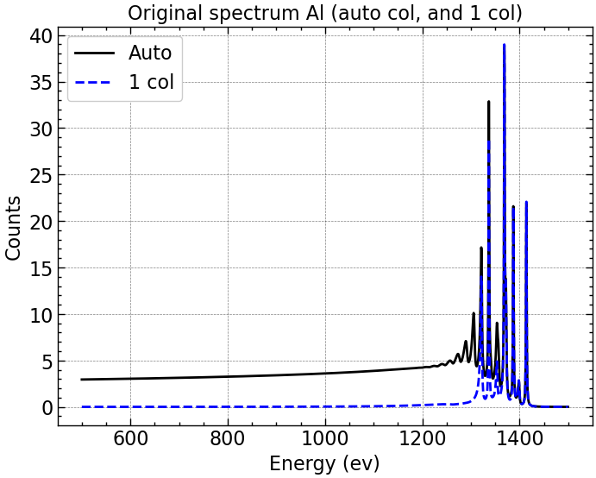
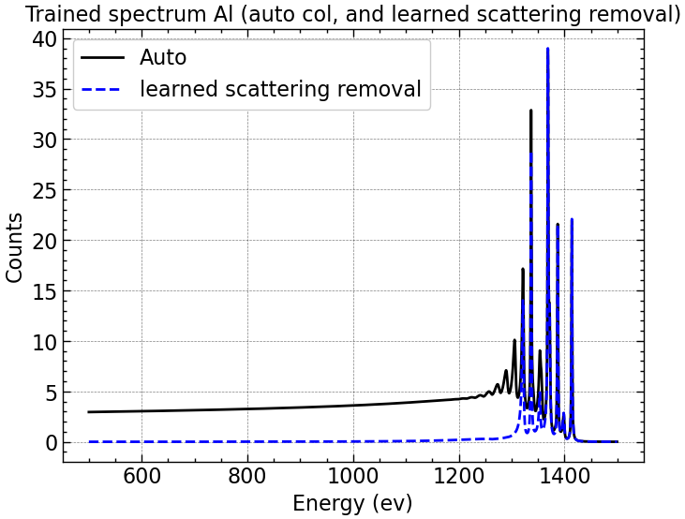
Training date vs. algorithm prediction of scattering-removed spectra.
At least results with training data are great. We could also plot the absolute error (which should be captured by the loss to some extent), but we can check correctness visually.

Slide 9
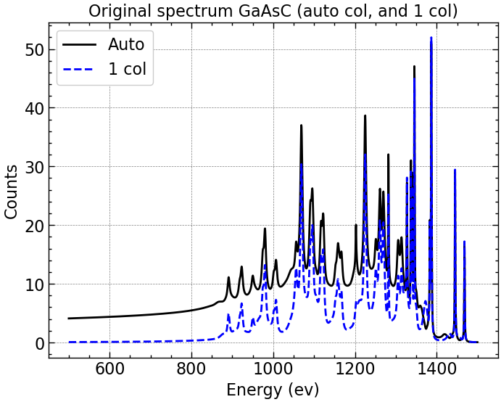
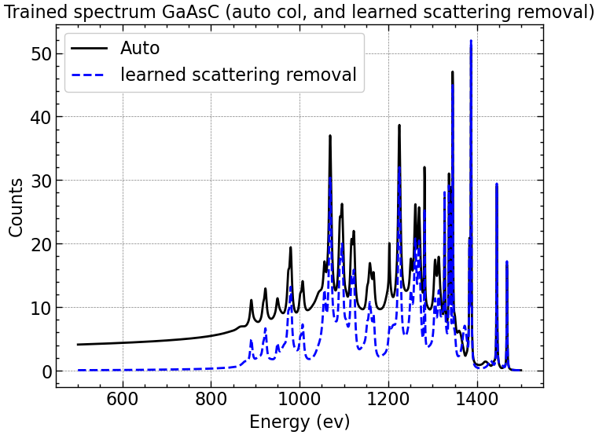

Slide 10
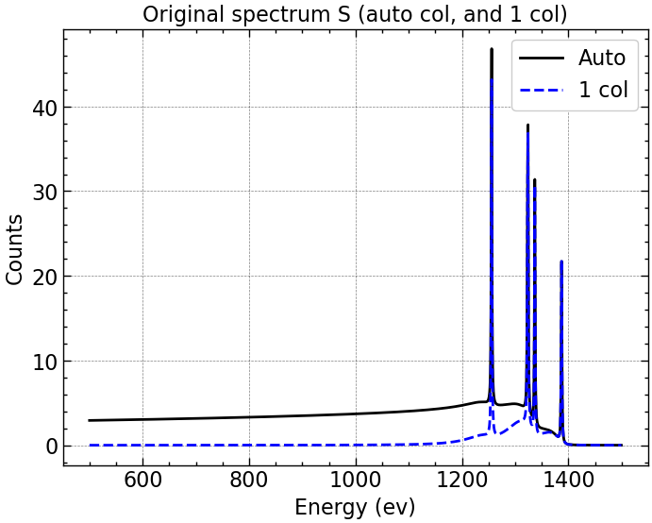
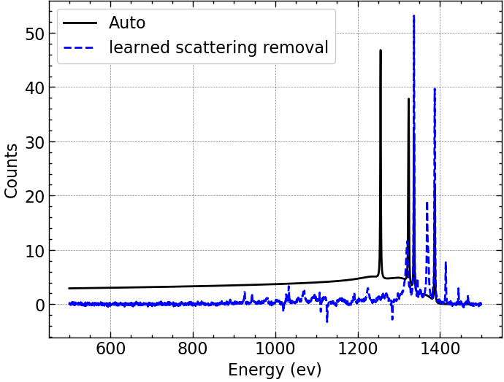
Testing on data with diff materials or thicknesses was not adequate:
Testing a material not in our training data does not perform well.

Slide 11
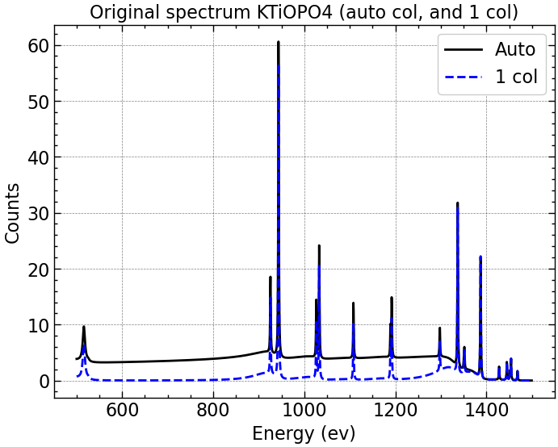
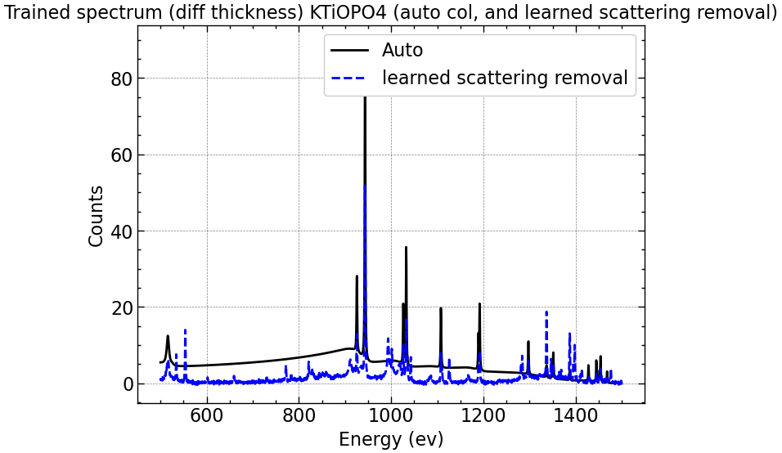
Testing different thicknesses also did not do well.

Slide 12
To do:
Train algorithm to distinguish materials with poisson noise. Test!
Test algorithm to distinguish materials with thicknesses closer to the reference thickness of 10 Angstroms.
Introduce more materials and thicknesses to scattering-removal algorithm. It seems as if we HAVE to train the algorithm on a material we’re going to test, but we probably don’t have to test on exact thicknesses we’ve trained on, as long as the deviation is not great.
Train algorithm to determine stoichiometry!

